Slide 1
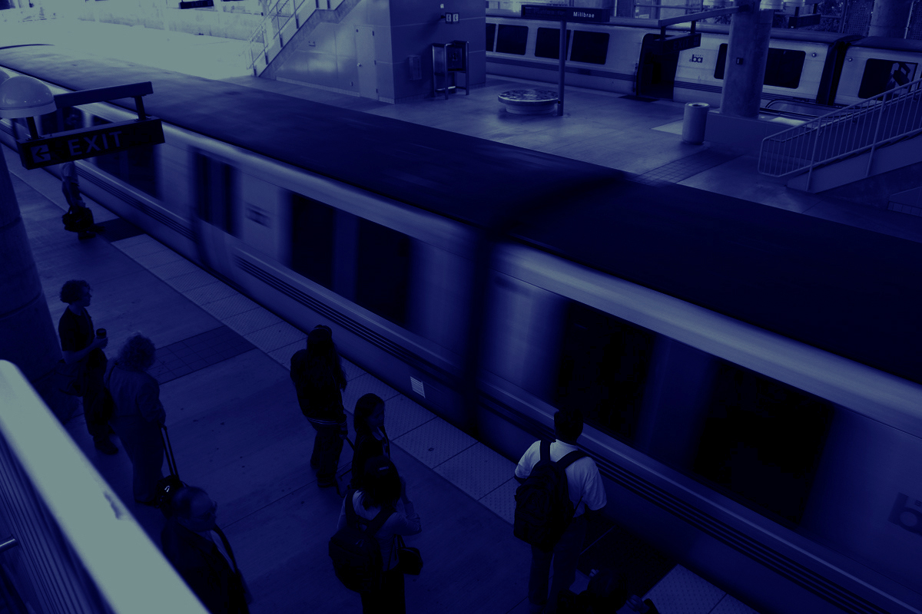

Location, Location, Location:
The hot trend in social media marketing
Melissa Jordan,
Senior Marketing Representative
Web 2.0 Expo
May 5, 2010

Slide 2
WHY? Did BART partner with Foursquare
WHAT? Did we learn from the partnership
HOW? Can it help your business or brand in getting into location-based social marketing

Slide 3
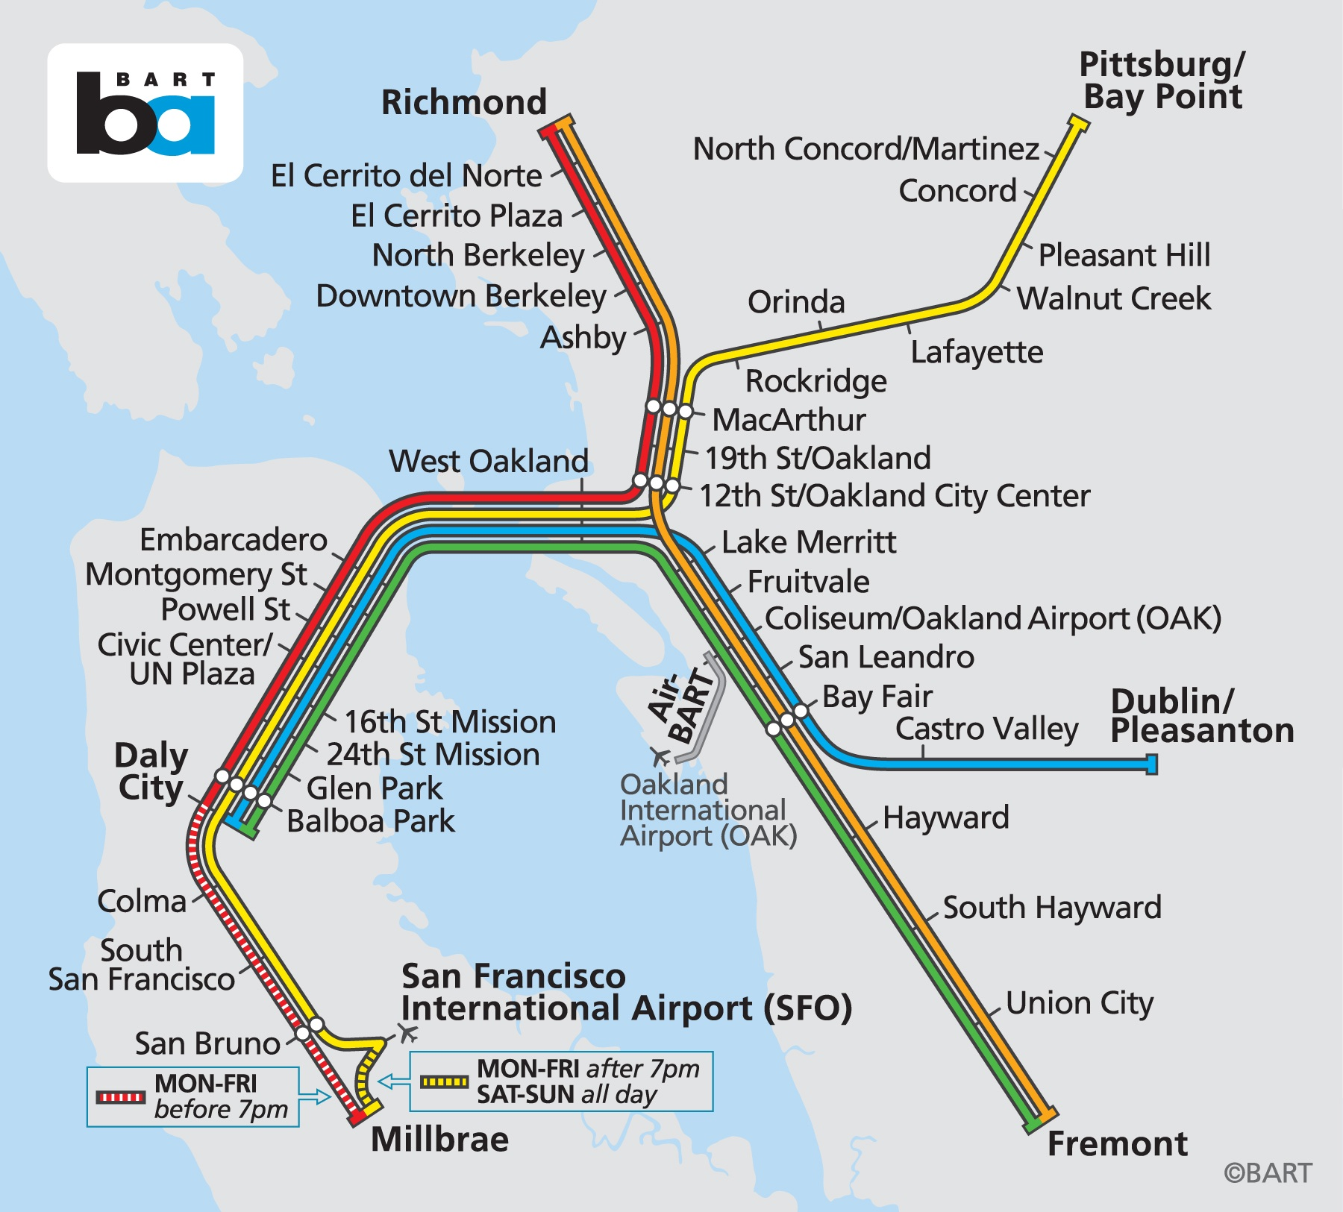
WHY?
It’s a perfect fit
Transit by definition is a location-based service − we are moving people from location to location − so an app like Foursquare that provides location-based social networking is useful for our customers.

Slide 4
WHAT?
Data gives us insight into our customers

Slide 5
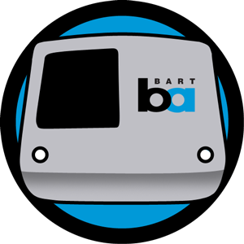
WHAT?
Data gives us insight into our customers
Market research survey showed:
43% had recommended a destination near BART
38% were having “more fun”
23% earned frequent rider badge
19% rode BART because of a 4sq recommendation
17% connected with friends
14% rode BART more because of their interaction with 4sq

Slide 6
Foursquare helps us understand our
customers’ habits and interests better

Slide 7




Lisa X. nMayor of Civic Center Station nHas the Zagat, pizzaiolo, ziggy’s wagon and barista badges
Foursquare helps us understand our
customers’ habits and interests better

Slide 8


Lisa X. nMayor of Civic Center Station nHas the Zagat, pizzaiolo, ziggy’s wagon and barista badges
Foursquare helps us understand our
customers’ habits and interests better
Craig W.
nMayor of Berkeley Station
nLoves to travel,has the jetsetter badge, as well as the gym rat badge

Slide 9
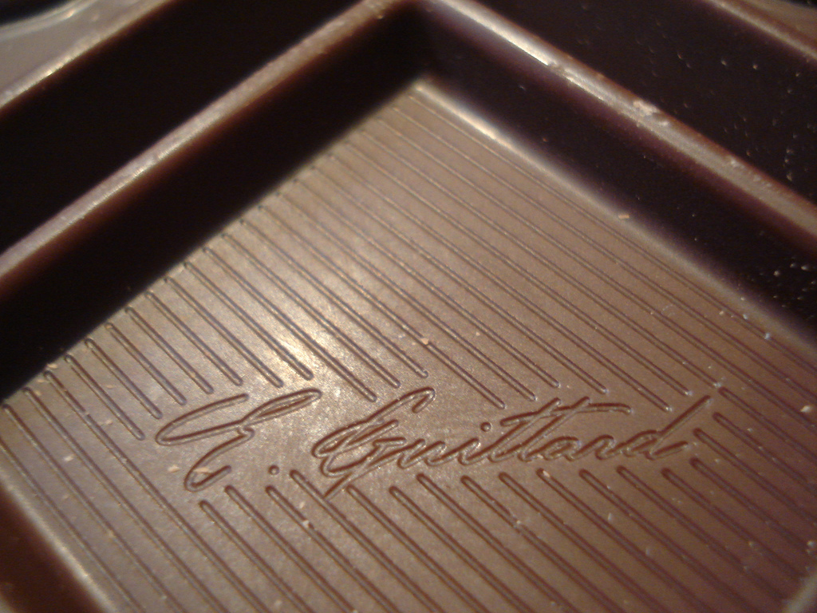
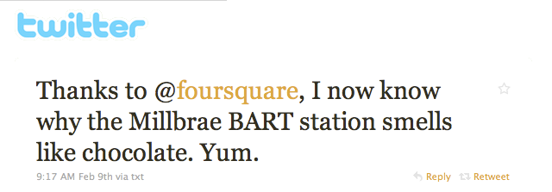
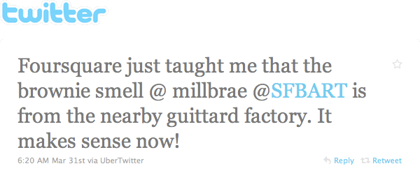
Foursquare helps us connect with customers,
answer questions and recommend tips
Photo by David Blaine

Slide 10
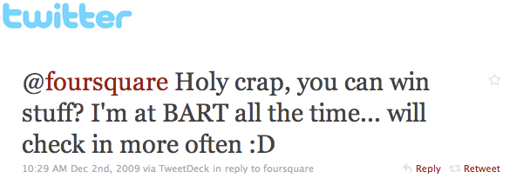
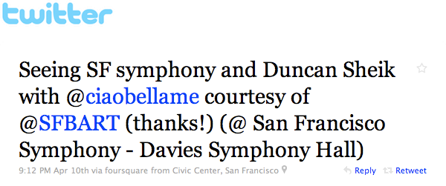
PEOPLE LOVE FREE STUFF!
Foursquare lets us promote to them in ways that will match their interests

Slide 11
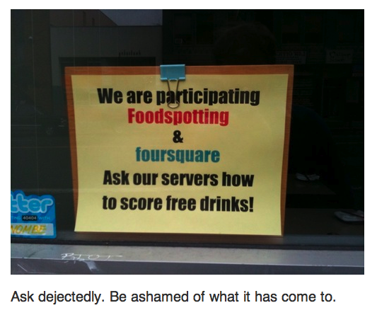
Even snarky bloggers love free stuff! (from www.sexpigeon.org)
Photo by sexpigeon.org

Slide 12
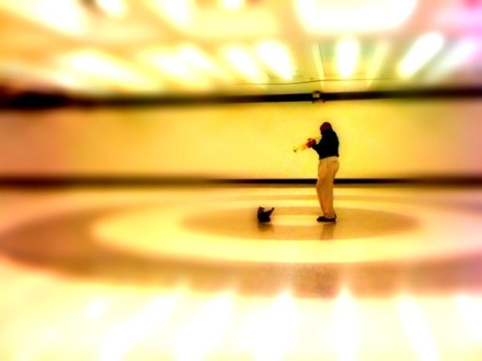
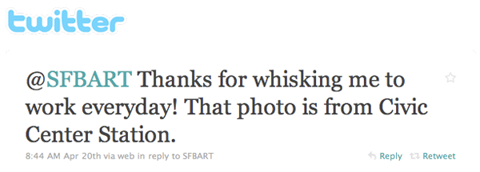
These check-ins and
connections build loyalty
Photo by Z

Slide 13

BUT … and this is a big BUT − location-based services have to step up and provide MORE functionality and tools that brands can use, and businesses need to speak up and ask for what they need.
WE HAVE NEEDS!

Slide 14

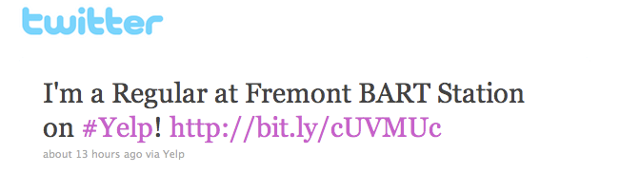
SO WHAT’S NEXT?
“We’re on the map!” - Google Places identifies venues with QR codes
Yelp lets you be a “regular”

Slide 15
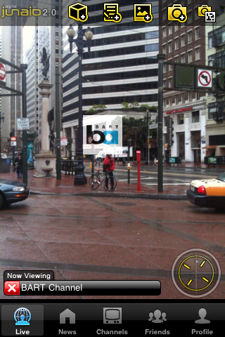
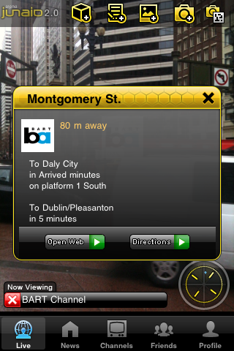
AUGMENTED REALITY
Partnerships with firms like Junaio let us add a real-time layer to our LBS info. For example, our open data API lets Junaio pull in real-time train arrivals when people check in at stations.

Slide 16
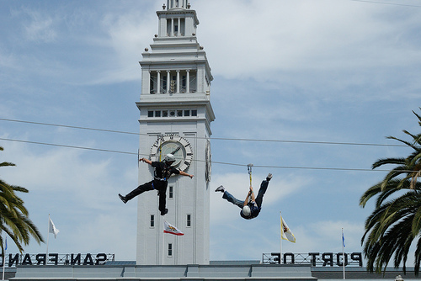
THE SWEET SPOT
Location-based, real-time promotions − as well as partnerships with advertisers.
ALERT!
Since you’re at Embarcadero Station, did you know there’s a free zipline at Justin Herman Plaza through Sunday?
Photo by blarfiejandro

Slide 17
HOW CAN YOU GET STARTED
nStart small: just get started.
nClaim your venues; use the tools available.
nKnow your customers.
nUse LBS to give customers a better experience.
Notes:
Start small: just get started. Mobile and smartphone penetration are increasing and you don’t want to be left behind on location-based marketing
nClaim your venues, use the tools available, most are currently free
nKnow your customers and what their needs and interests are
n Use LBS to give your customers more value and a better experience

Slide 18
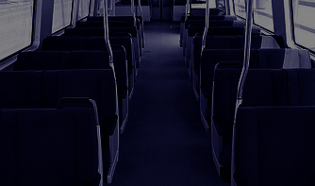
It’s 11:45 a.m. -
Do you know
where your
customers are?
Questions? E-mail me at mjordan@bart.gov
Photo by Adam UXB Smith

